Slide 1

Nikhitha Regula employee id : 200125 Designation : Functional Test Engineer

Slide 2

JENKINS PROJECT

Slide 3
Project overview
Creating the Spring boot project using eclipse IDE
Pushing code to git hub
Building the project using jenkins

Slide 4
Tools used
Eclipse IDE
Git hub
Jenkins

Slide 5
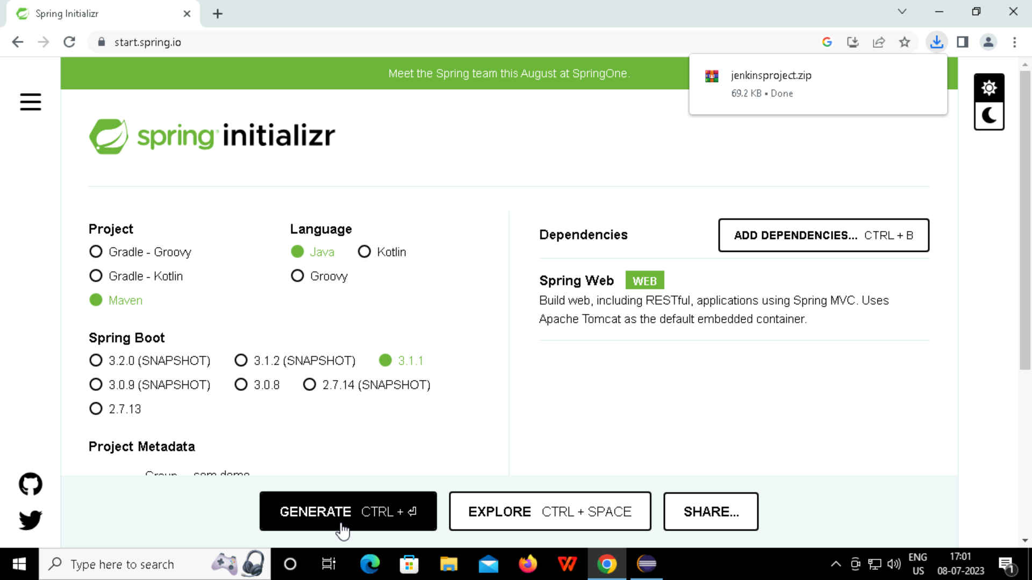
Open the browser and search for spring initializr

Slide 6
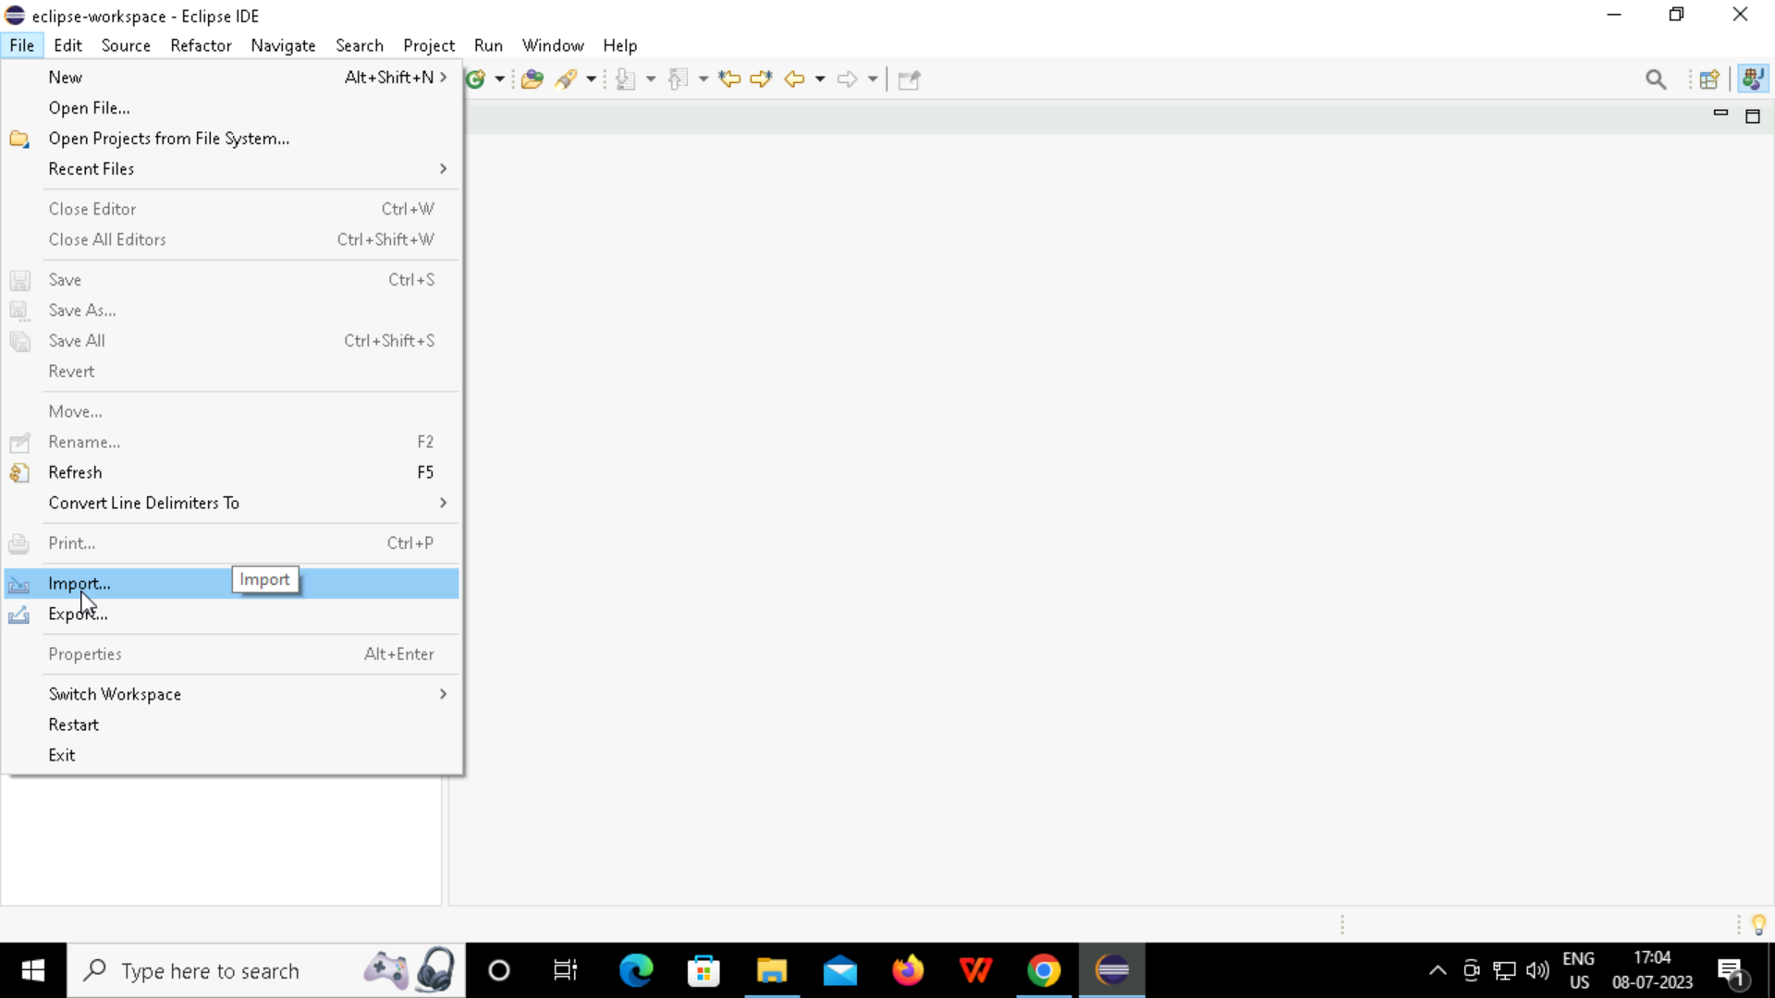
Import the zip file generated in spring Initializr to eclipseIDE

Slide 7
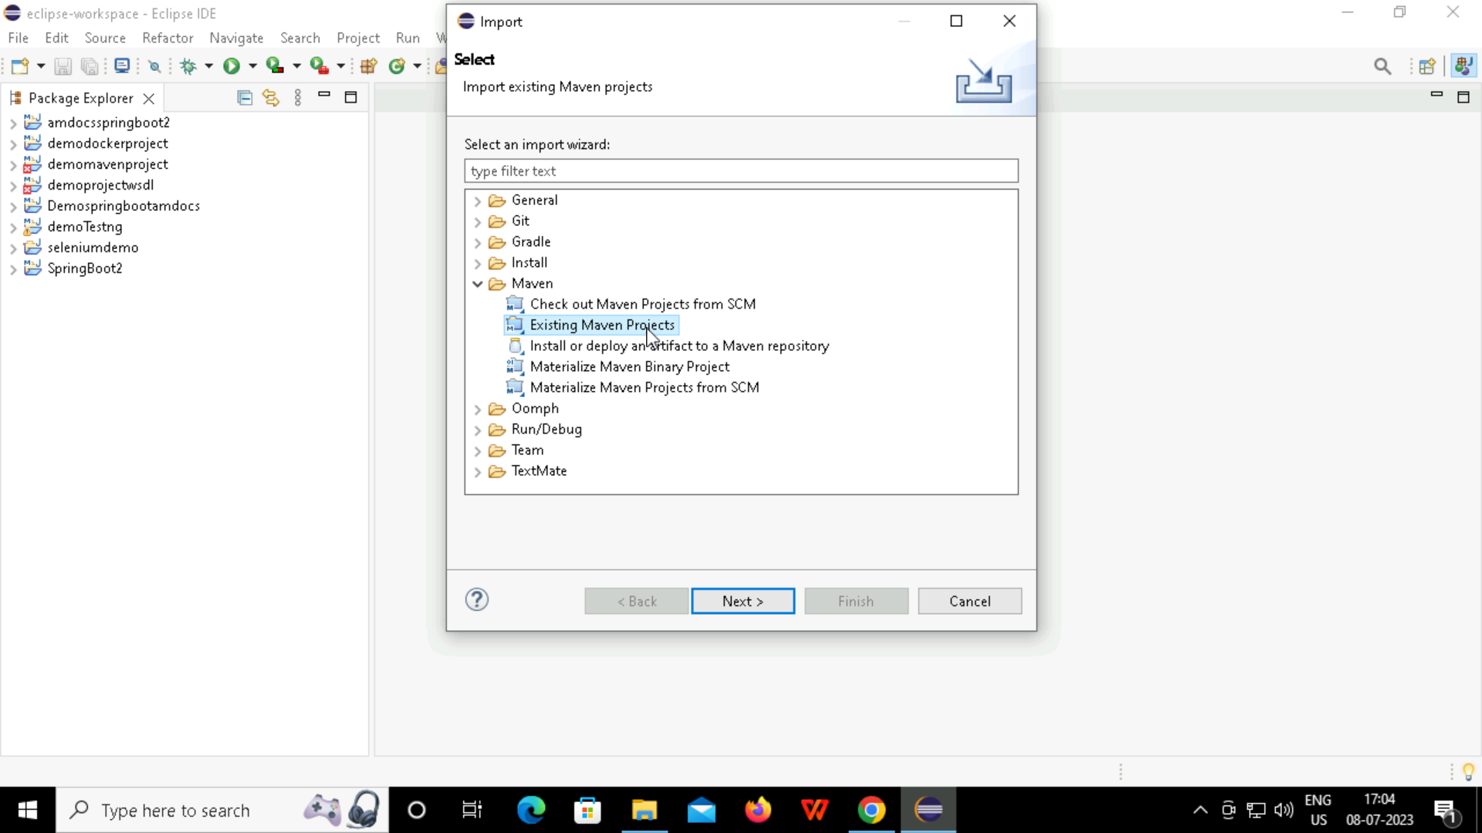

Slide 8
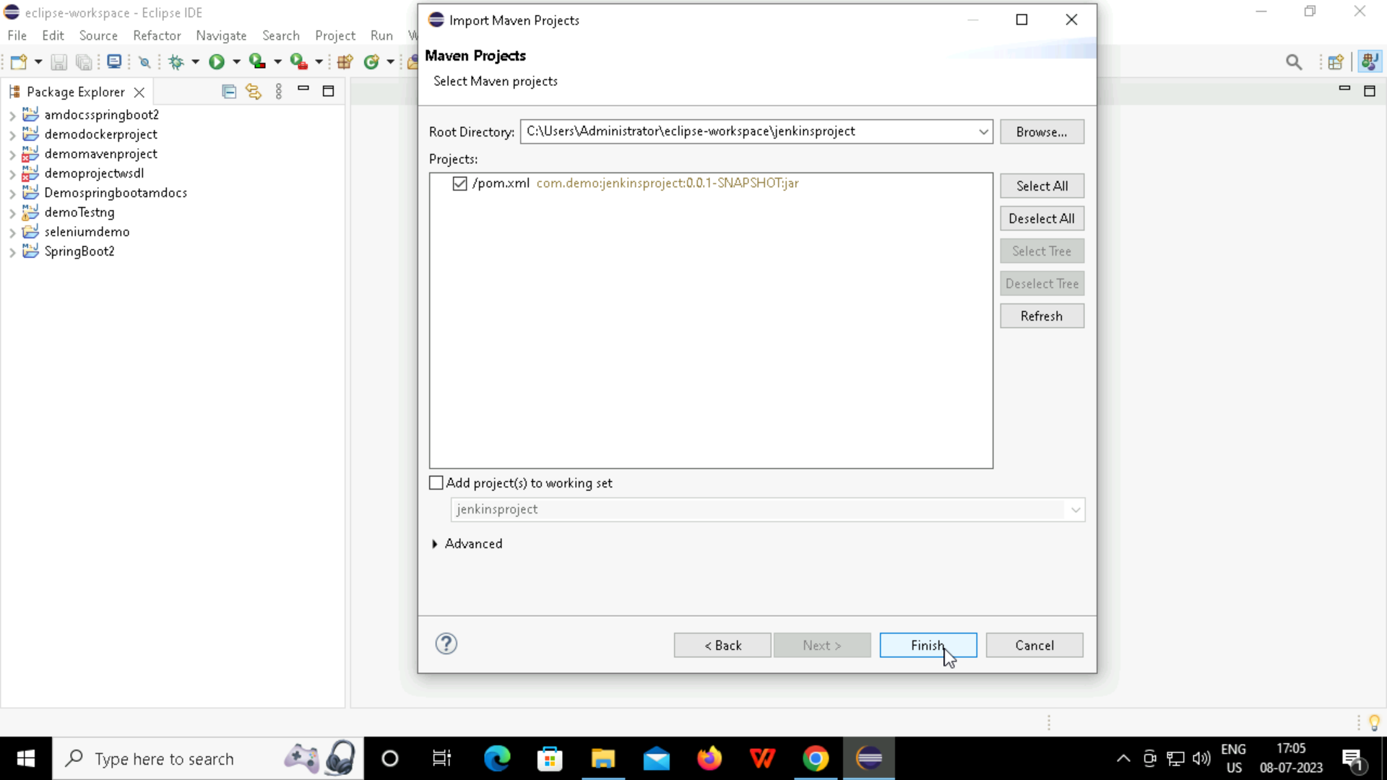

Slide 9
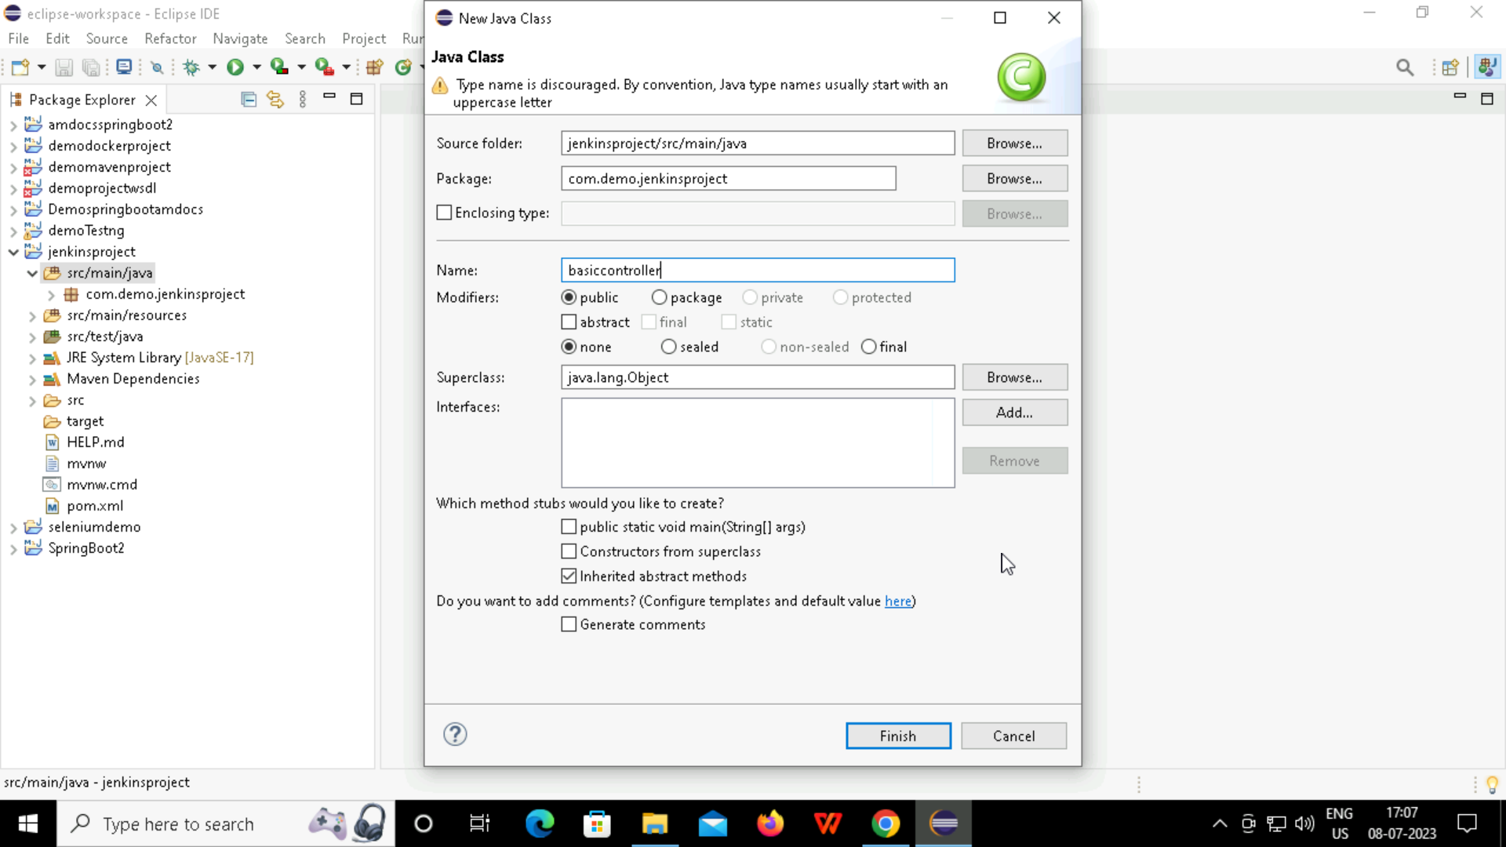

Slide 10
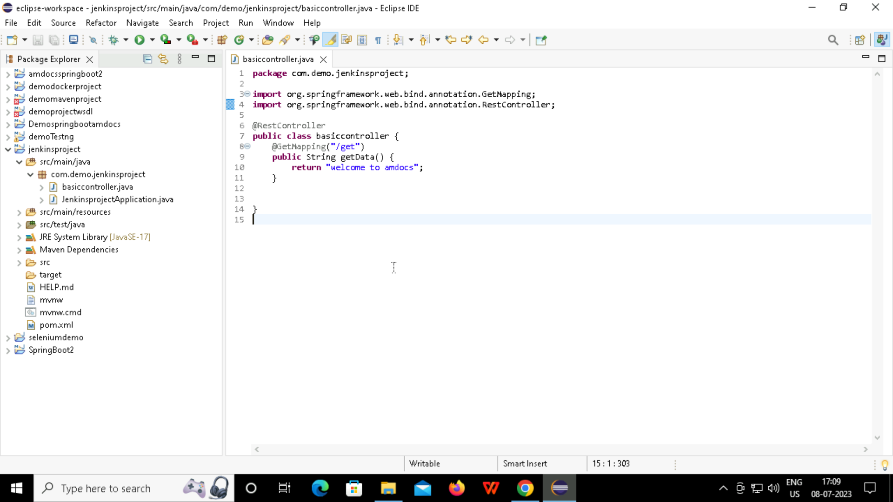

Slide 11
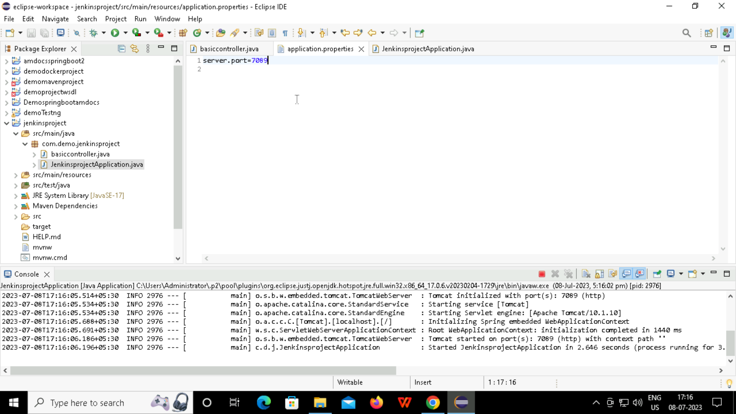

Slide 12
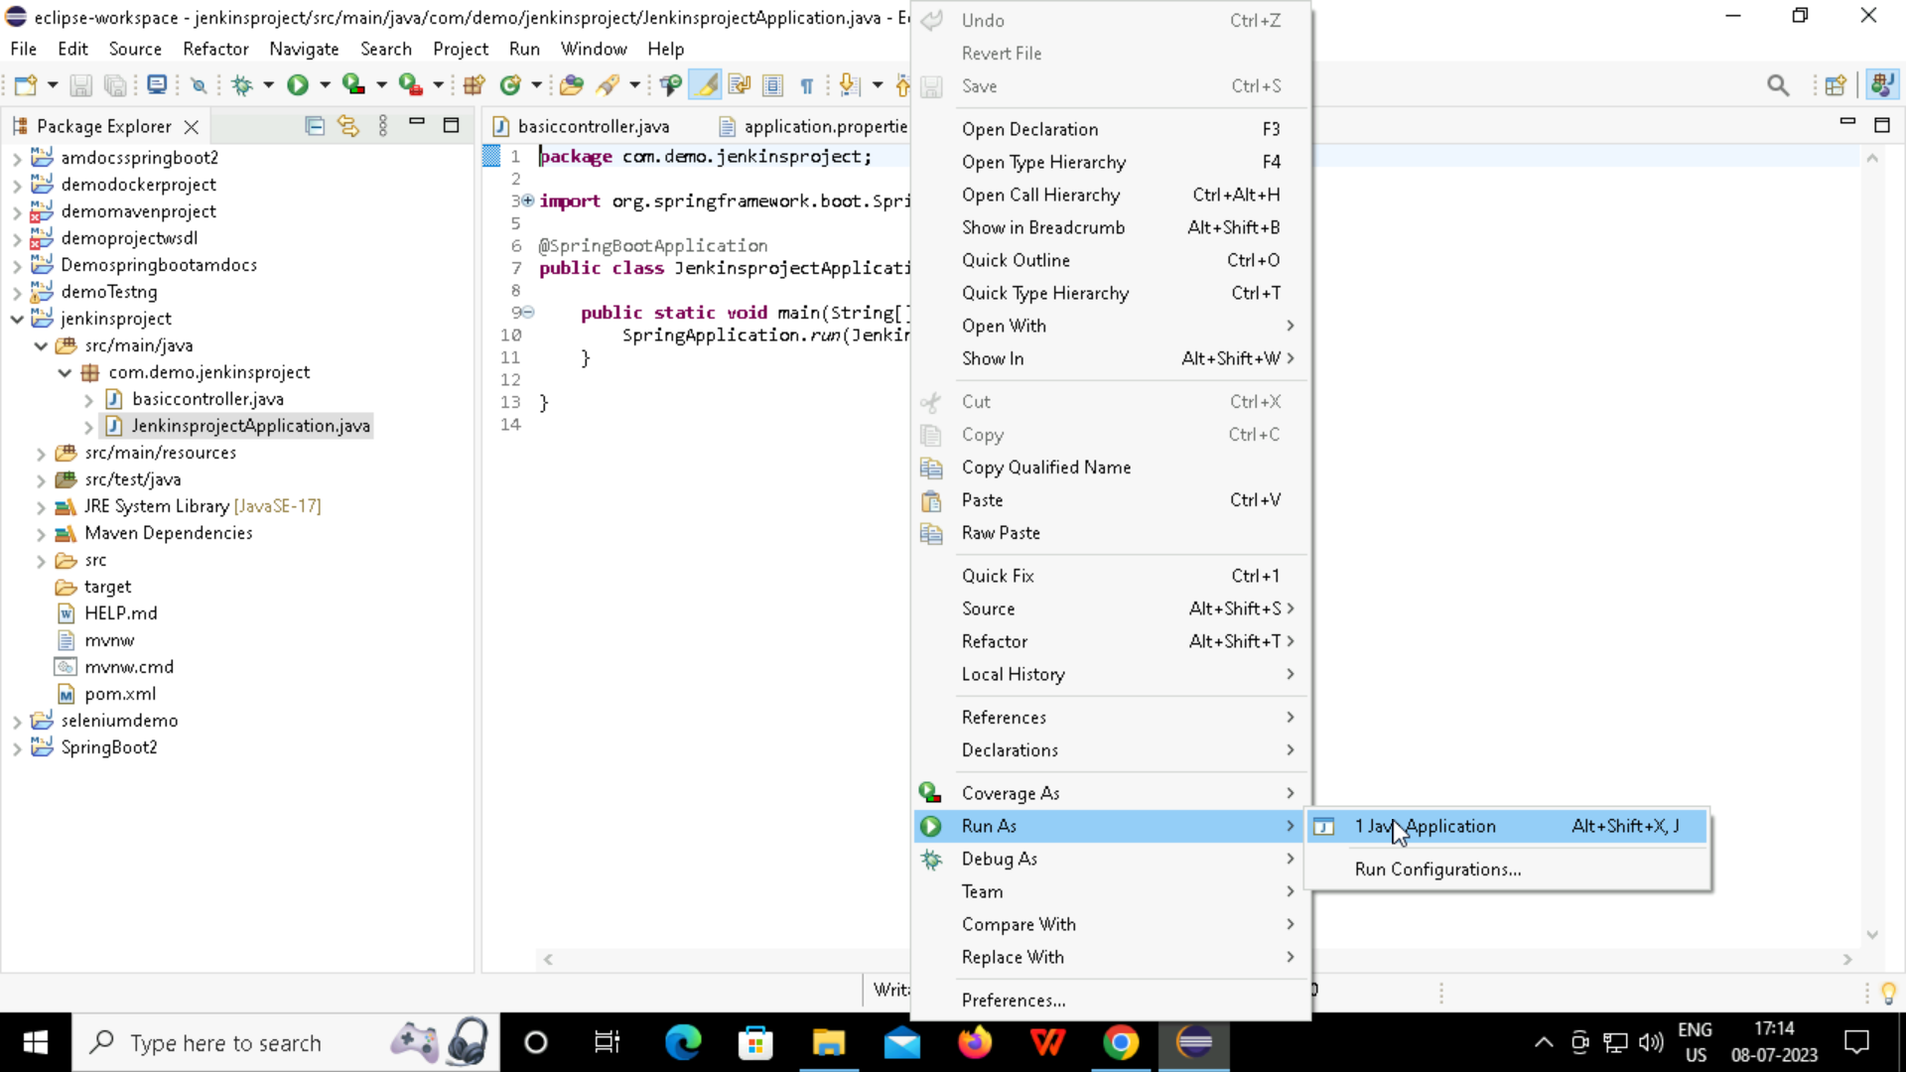

Slide 13
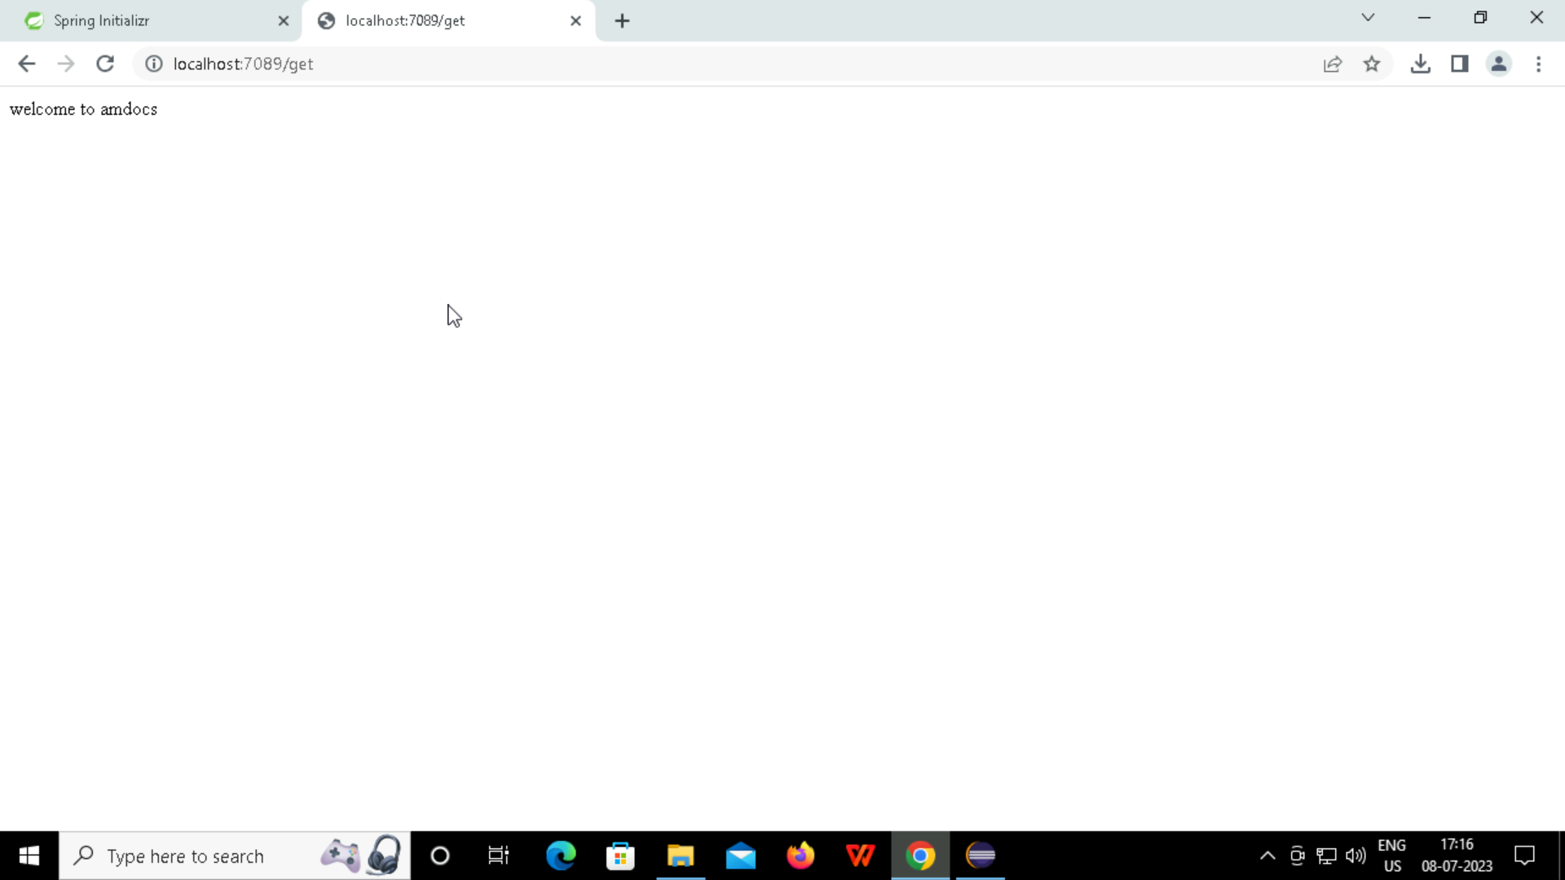
Output of the spring boot project

Slide 14
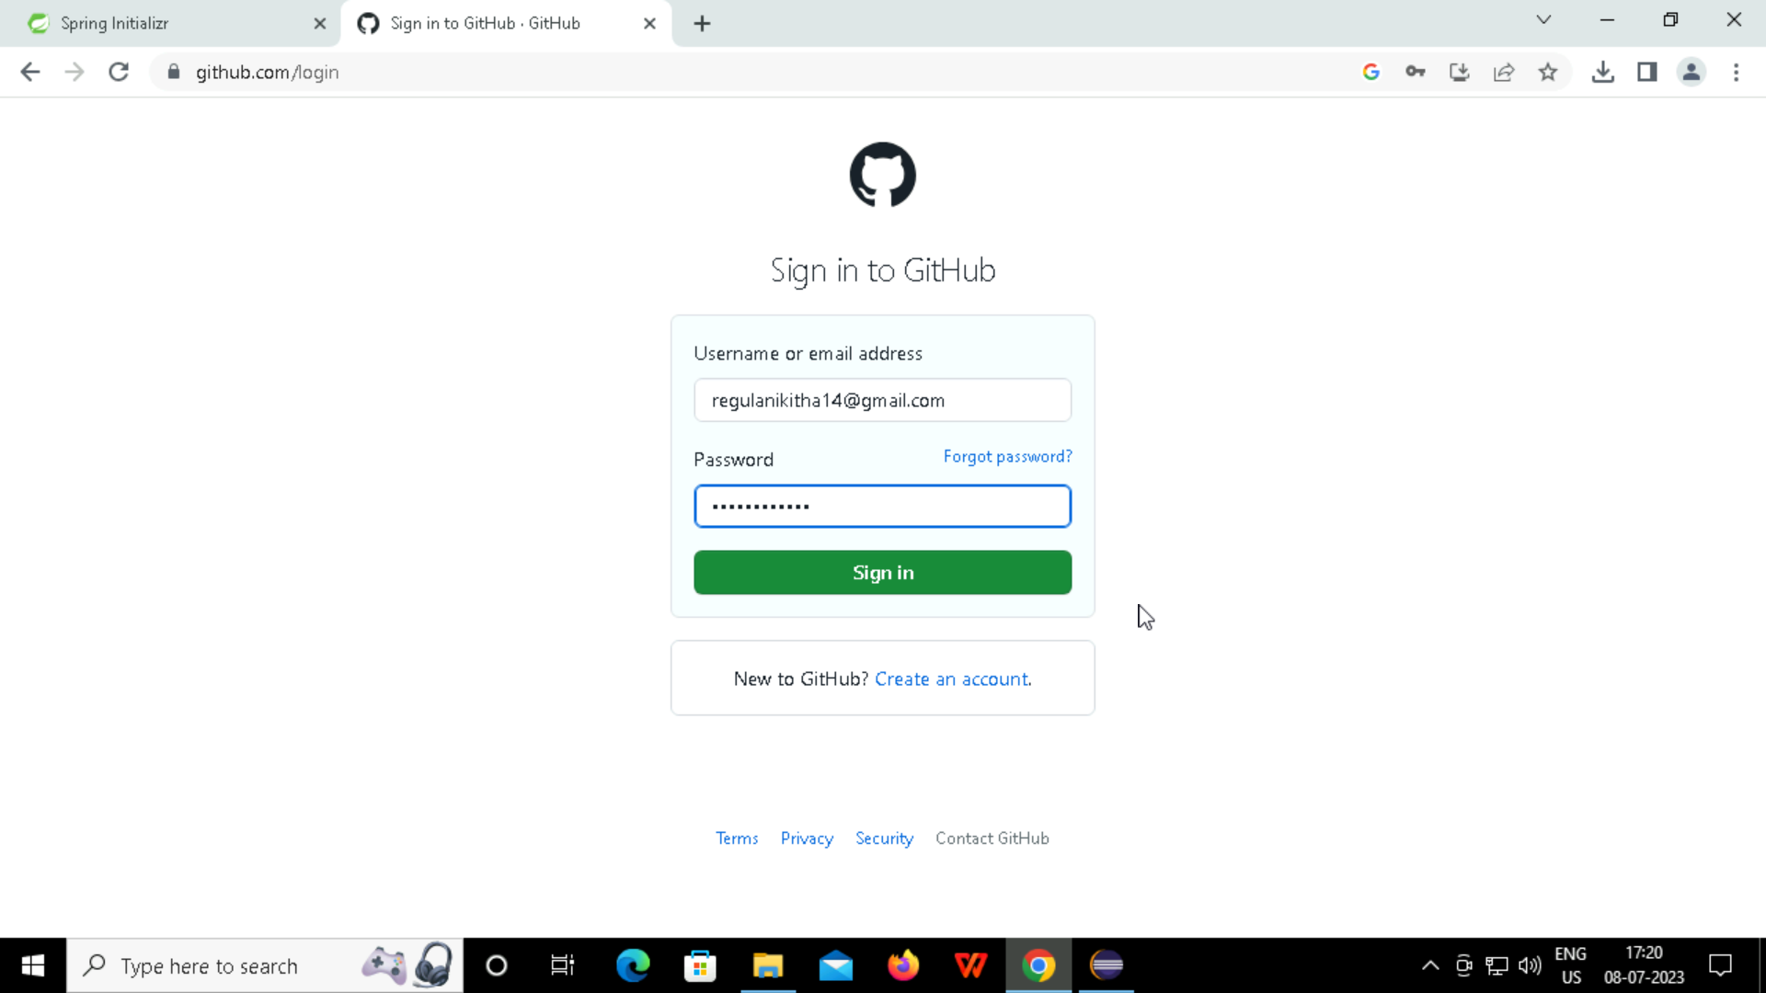
Opening the github for pushing the spring boot project

Slide 15
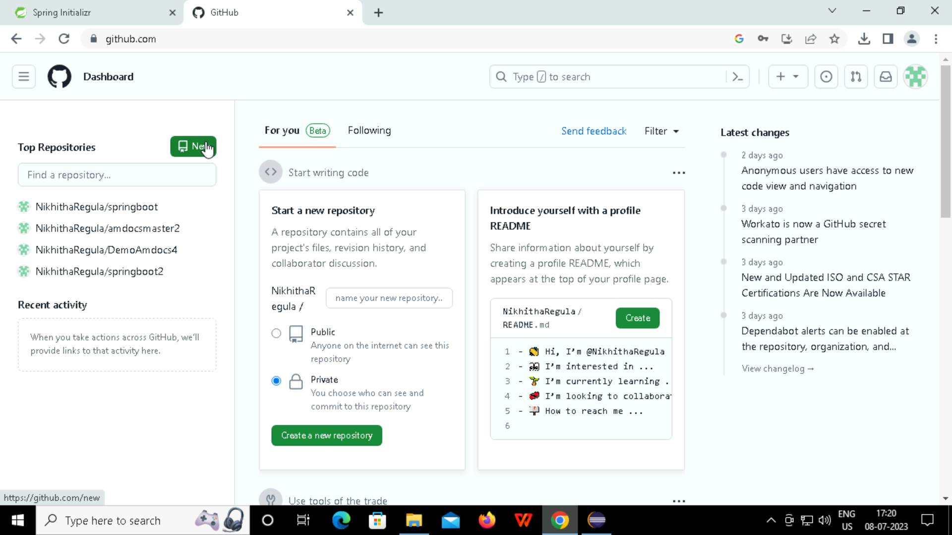
Creating New Repository in github

Slide 16
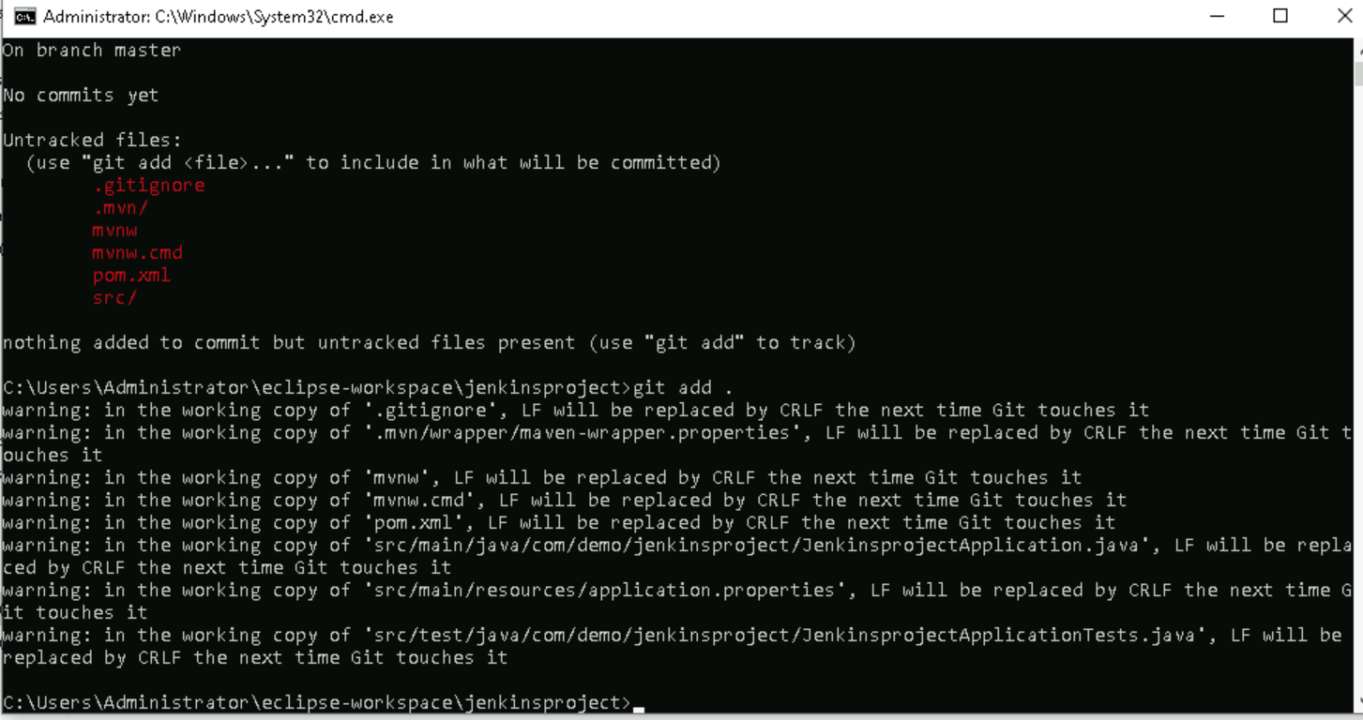
Pushing the code into the github

Slide 17
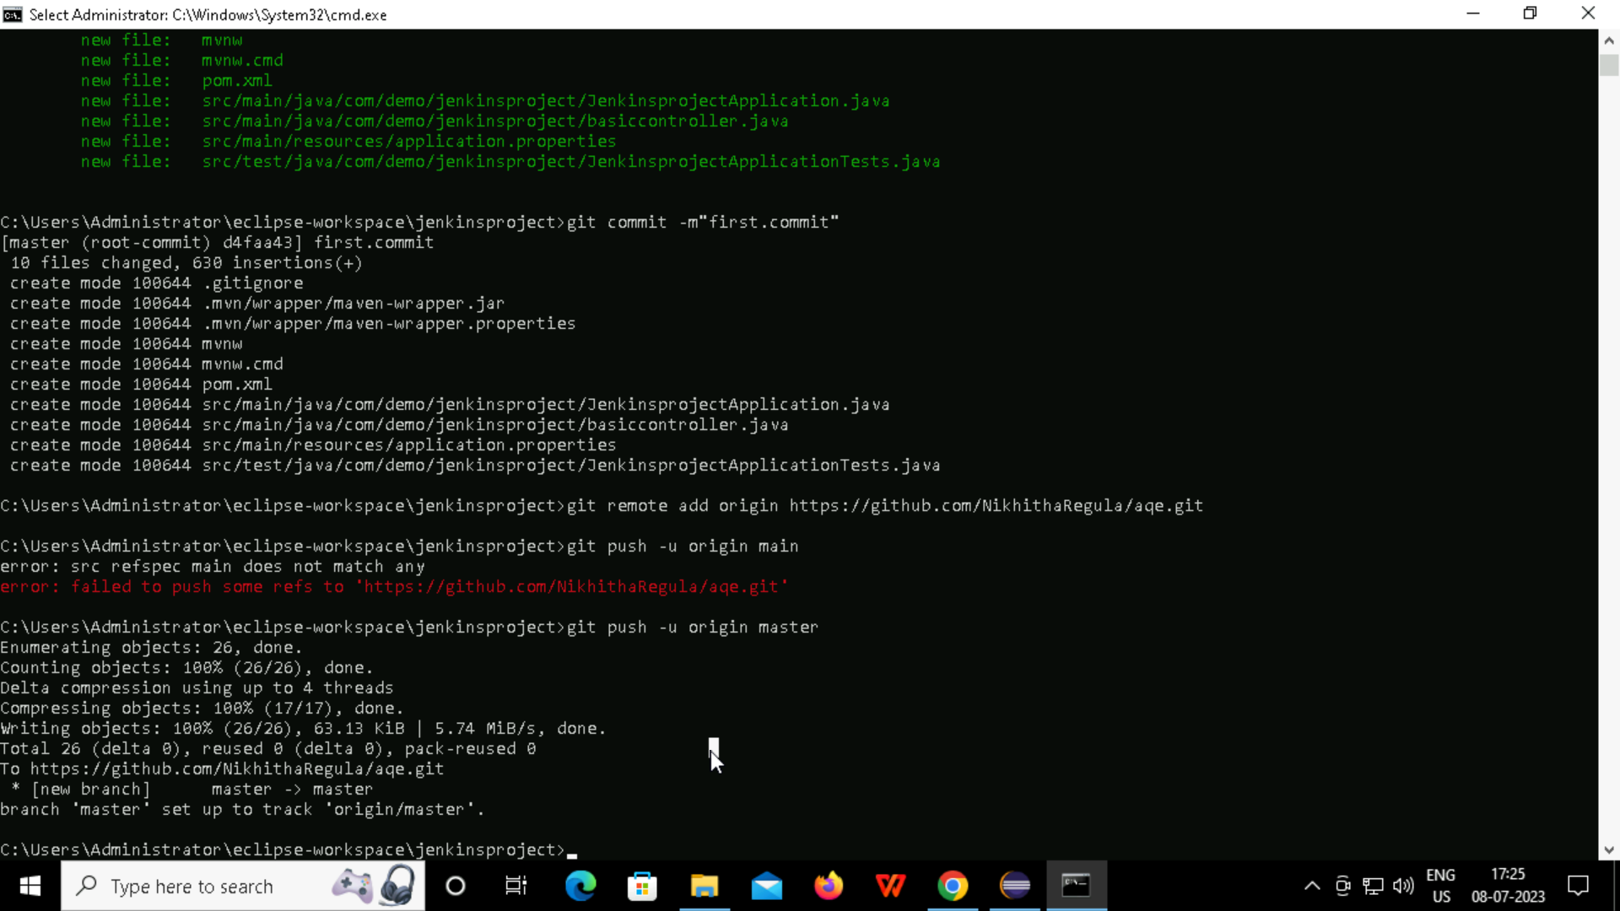

Slide 18
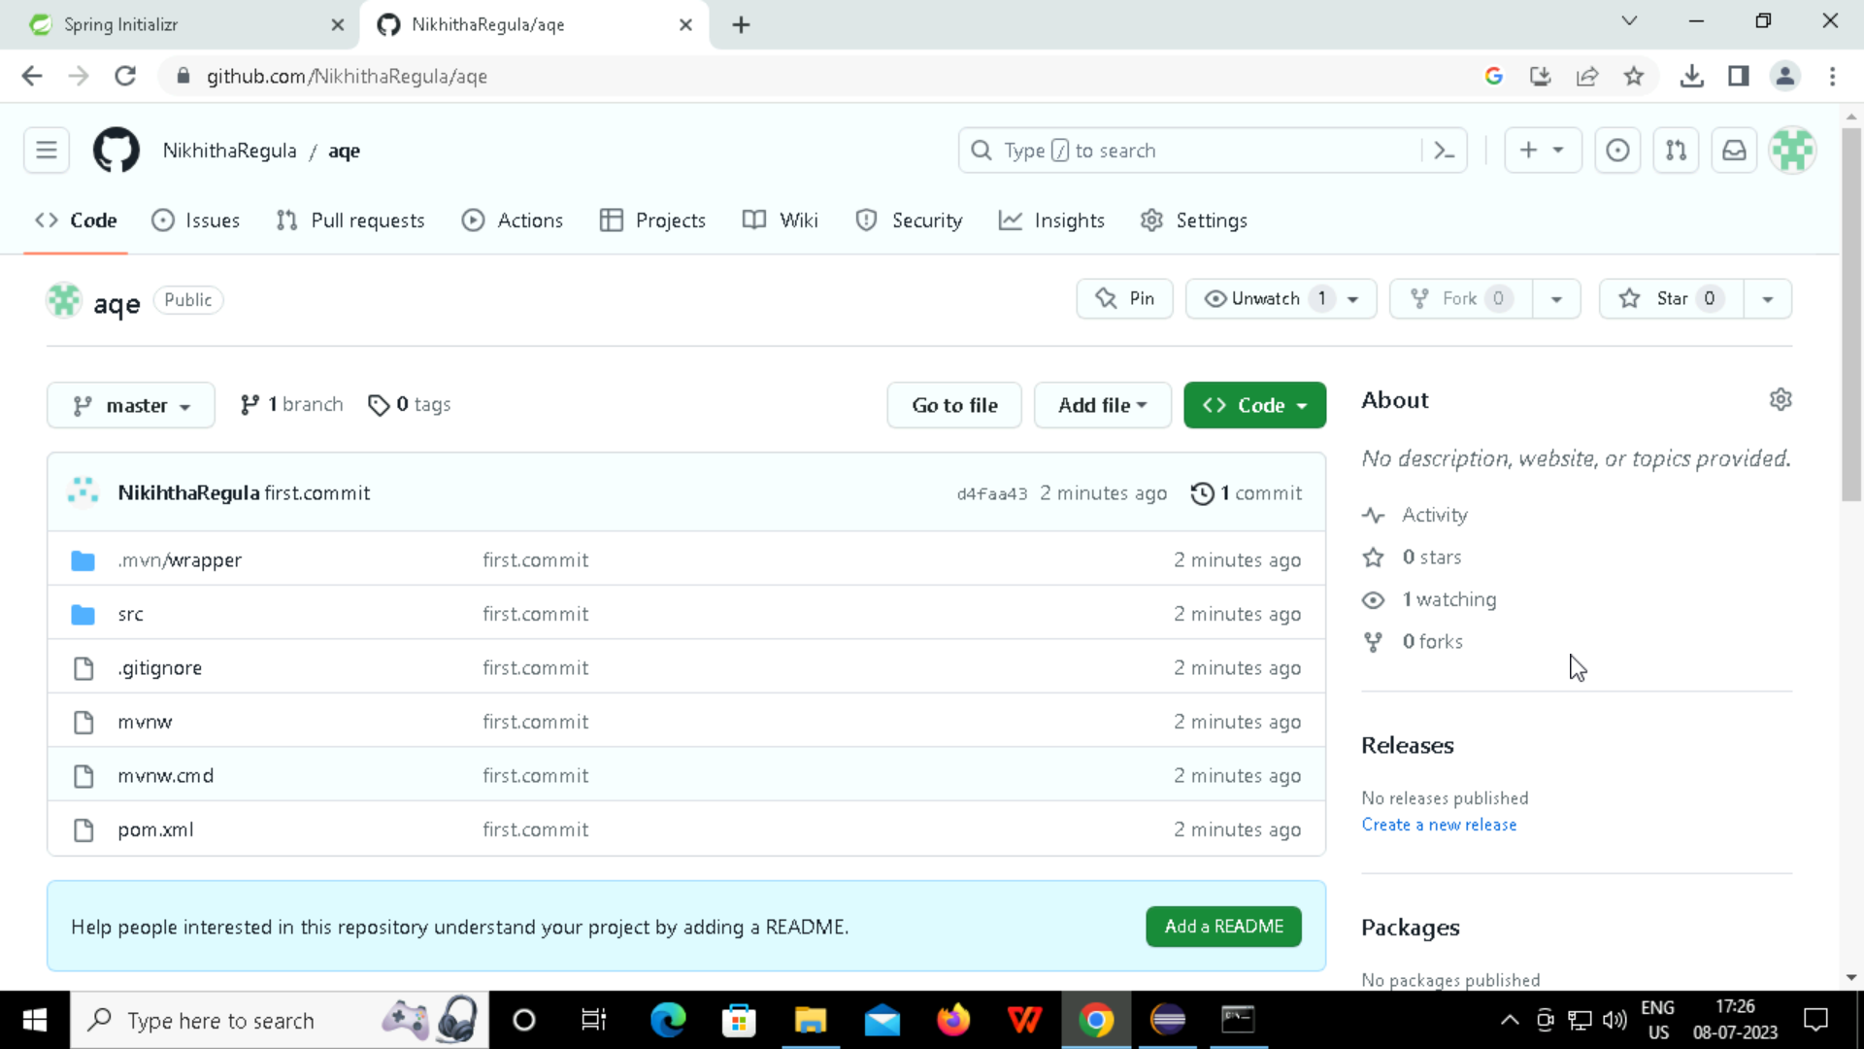

Slide 19
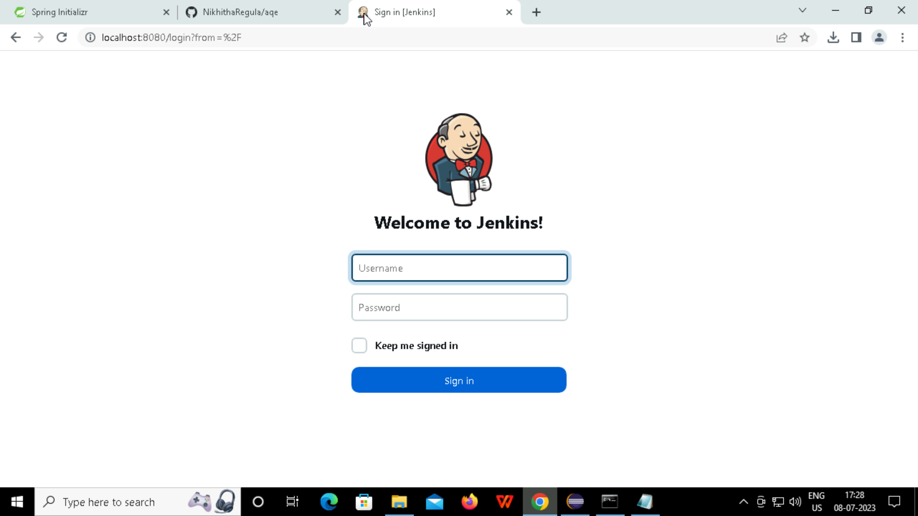
JENKINS
The open source automation server .
Jenkins provides hundreds of plugins to support building, deploying and automating any project.

Slide 20
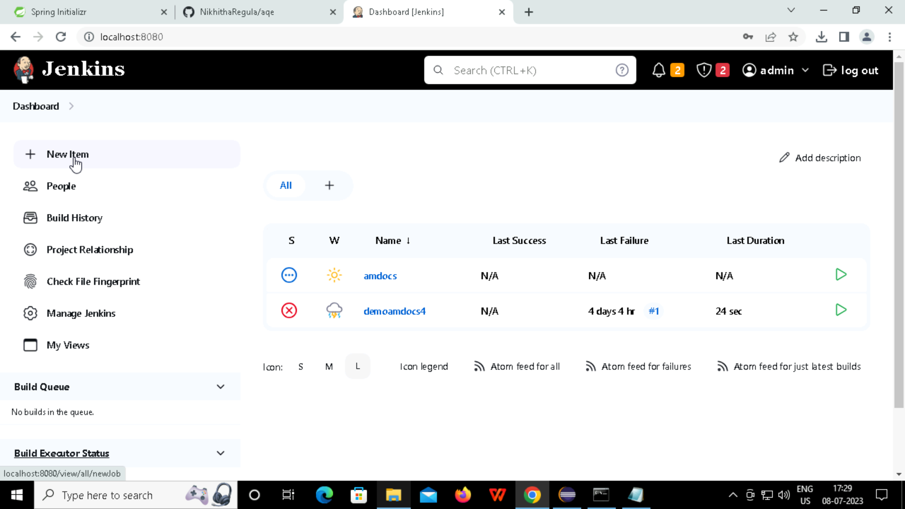

Slide 21
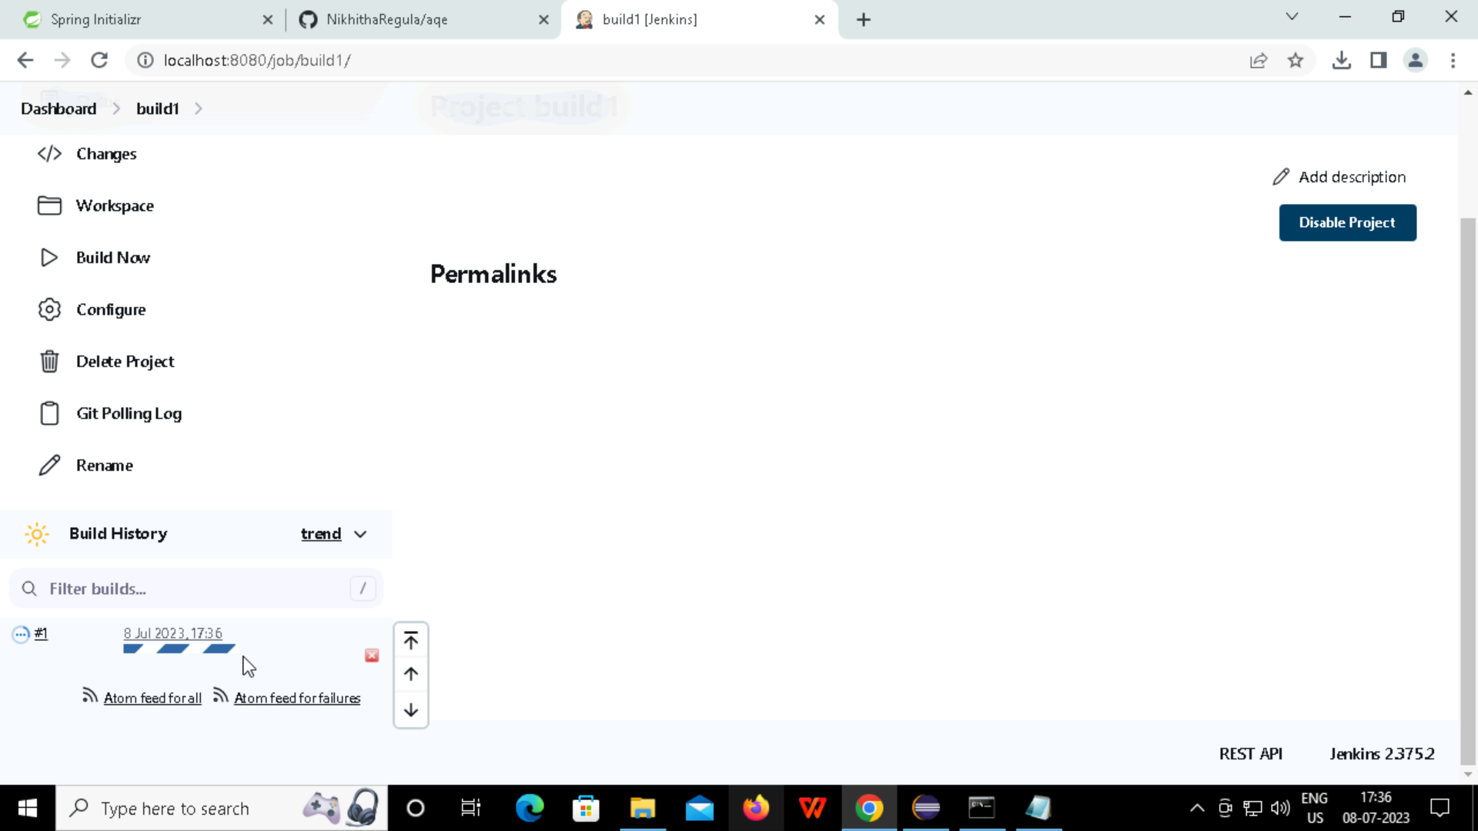

Slide 22

Selenium
Selenium is a free (open-source) automated testing framework used to validate web applications across different browsers and platforms.

Slide 23
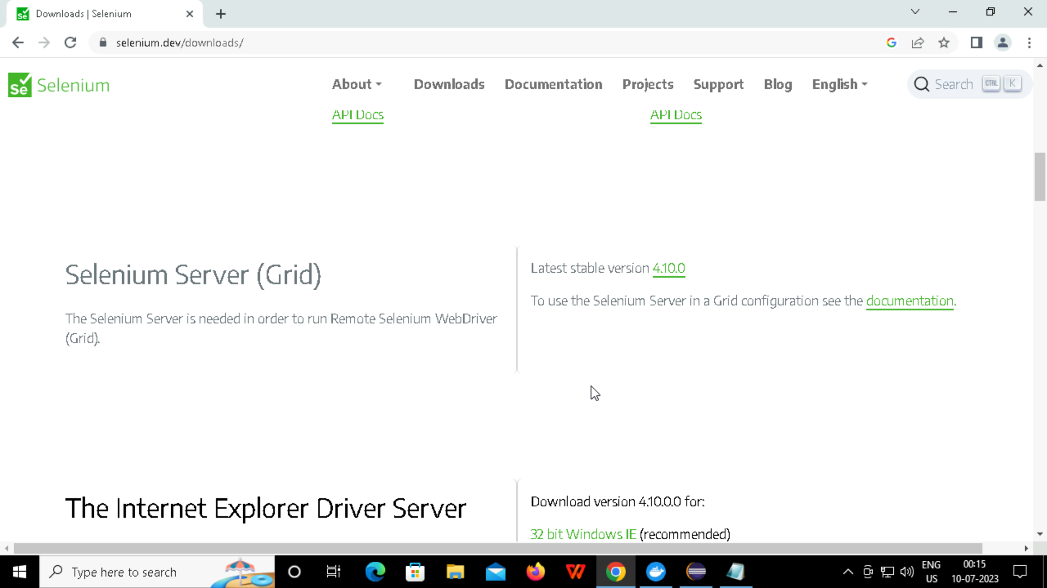

Slide 24
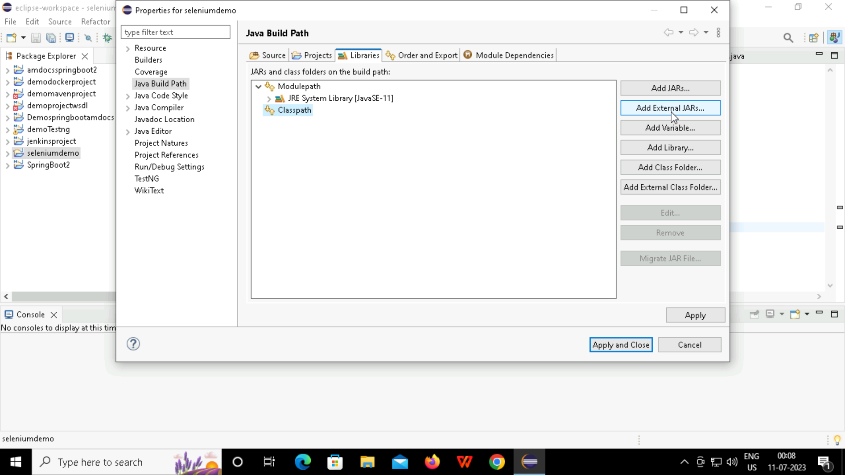

Slide 25
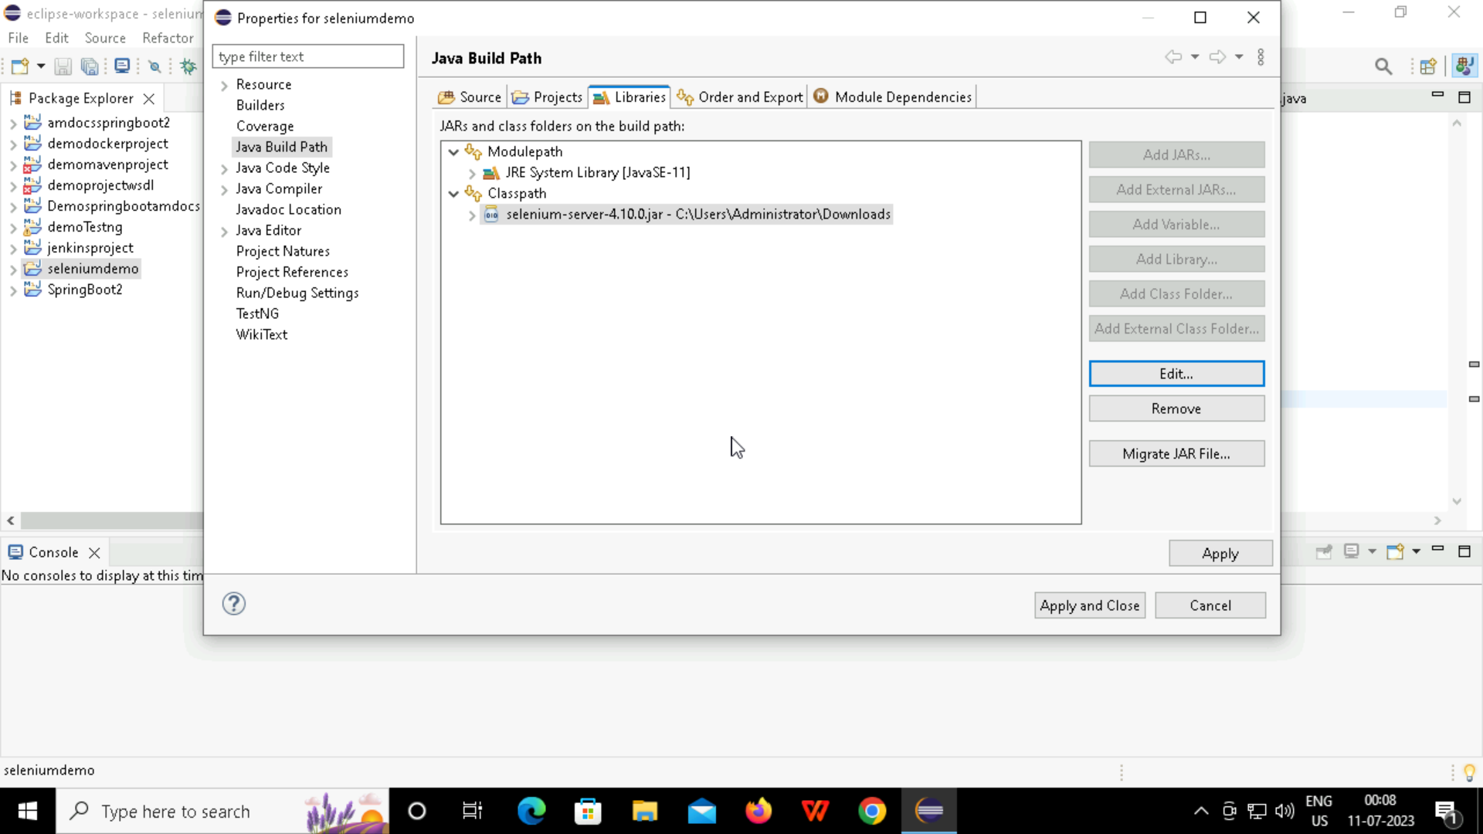

Slide 26
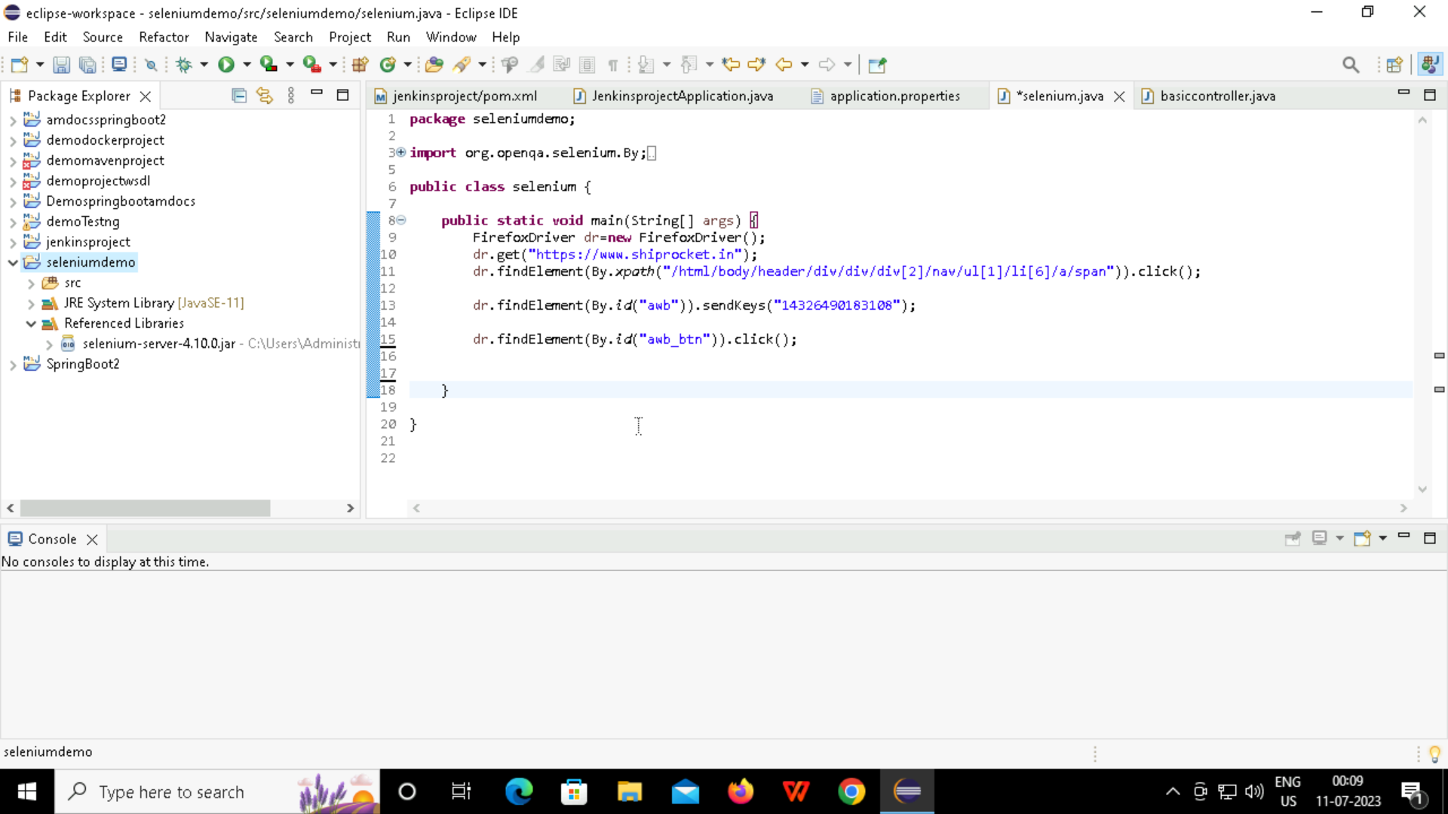
Creating simple selenium project

Slide 27


